Slide 1
Benefits Claims Decision Support System Date: 2/08/16 PM: Elizabeth Wollin
Schedule | Staffing | Funding | Integration | Stakeholder Comms | VBA Overall | OI&T Overall
 | ● | ● | N/A | ● | ● | ●
Cross Dependencies: N/A
Completed this Week:
Brought SDD Up-to-Date
Brought RTM Up-to Date
Brought CPMP Up-to-Date
Outlined Plan for February
Implemented all HLRs into JIRA (High-Level Requirements)
Outlined Scrum 0 as a test for team in JIRA (test (Plan for February)
Overdue:
None
Due Next Week:
Outlining points of Analysis in Data for Ear Model
Running tests on data
Developing scripts to test as an outcome of above
Developing high-level model for platform
Developing high-level model for models database
Developing high-level model for platform database
Acquisition Package and CR Updates:
None

Slide 2
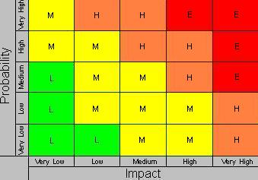
Benefits Claims Decision Support System Date: 12/11/15 PM: Elizabeth Wollin
Risk 1:
Title:
Risk: If delays in obtaining data.
Impact: The deliverables will be delayed.
Mitigation Steps to Date:
Regularly communicate timeline and data needs with VA PM.
Action Items:
VA PM working to obtain required agreements for data and data transfer.
Who: VA PM Due Date: Ongoing
Risk 2:
Title: Technical [12/11/15]
Risk: If expectations re: Mitre Scripts and Analysis duplication.
Impact: VA Stakeholder buy-in may not be obtained.
Mitigation Steps to Date:
Clearly Communication project approach and potential benefits with Business and Technical subject matter experts (SMEs).
Action Items:
Coordinates project meetings with Business and Technical SMEs.
Who: VA PM and Project Team Due Date: Ongoing
1
2

